Slide 1
Introduction:
Andrew Elliott, Jacob Cyr

Slide 2

Pokémon Background
The Pokémon franchise has become a global powerhouse since its inception in 1996, complete with a competitive gaming scene.
With the Esports industry generating over $1 billion in revenue annually, there is a growing demand for data-driven strategies to enhance tournament success.

Slide 3

Central Aim
Assist aspiring competitive Pokémon players in selecting winning strategies.
By analyzing key factors such as stats and typing, we can provide insights into which Pokémon are likely to perform well in tournaments.

Slide 4

Problem to be Solved
Identify the primary stats that contribute to a Pokémon's success, using “total stats” to gauge overall performance. Additionally, we aim to determine the prevalence of "good types” that are more likely to yield competitive Pokémon.

Slide 5

Process
We followed a structured approach to address the problem:
1
Part A: API Call & CSV Formation: Utilized PokeAPI to retrieve Pokémon data, including stats, typings, names, total stat, and evolution stage. This information was consolidated into a CSV file for analysis.
2
Part B: Cleaning and EDA: Conducted data cleaning and exploratory data analysis to understand the dataset better. This involved examining statistics, generating visualizations, and identifying outliers.
3
Part C: Quick SQL Demo: Demonstrated the ability to store data in a SQL database using the "fullgen_tophalf_pokemon.csv" file.
4
Part D: Regression Model: Utilized linear regression, ridge, and lasso models to determine the relationship between Pokémon stats and their overall performance.
5

Slide 6
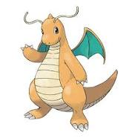
Results and Considerations
Top type: Dragon, indicating strong competitive viability.
Bottom type: Bug, which has lower average total stat values.
Powerful Types: Using an average power metric, the top three powerful types were identified as Psychic, Flying, and Dragon.
Weak Types: The three weakest are Poison, Grass, and Ground.
Typing Prevalence: Water, Psychic, and Grass are the three most common, while Ice, Fairy, and Bug are the least common types.

Slide 7
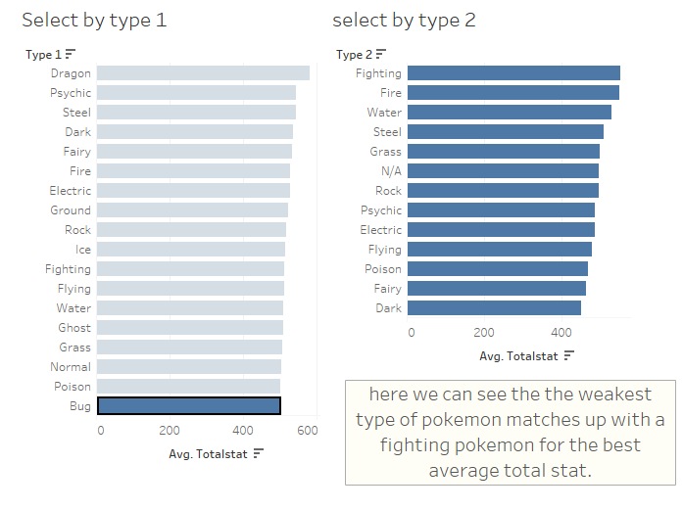
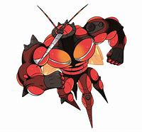
Example with Data: Buzzwole
When consulting extra sources to confirm the findings, we was able to come across Buzzwole, who visually fits the criteria of bug Pokemon with high fighting ability.

